Slide 1
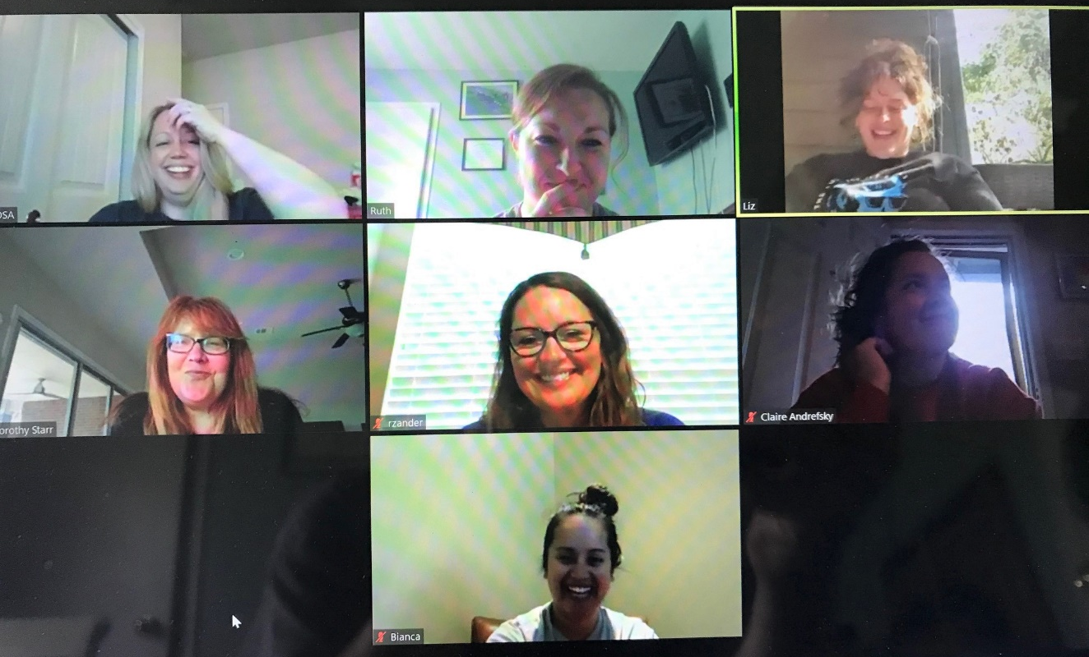
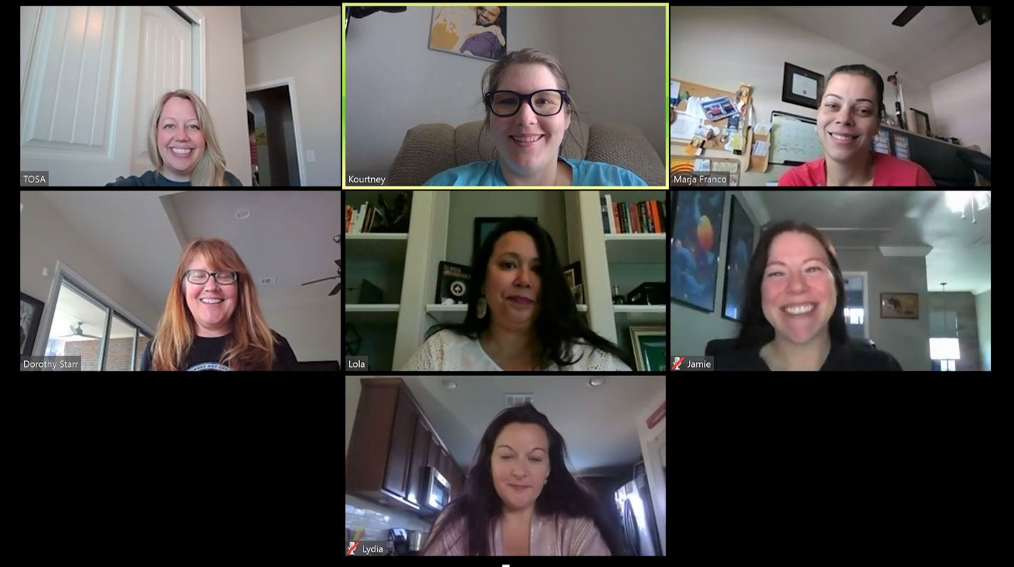
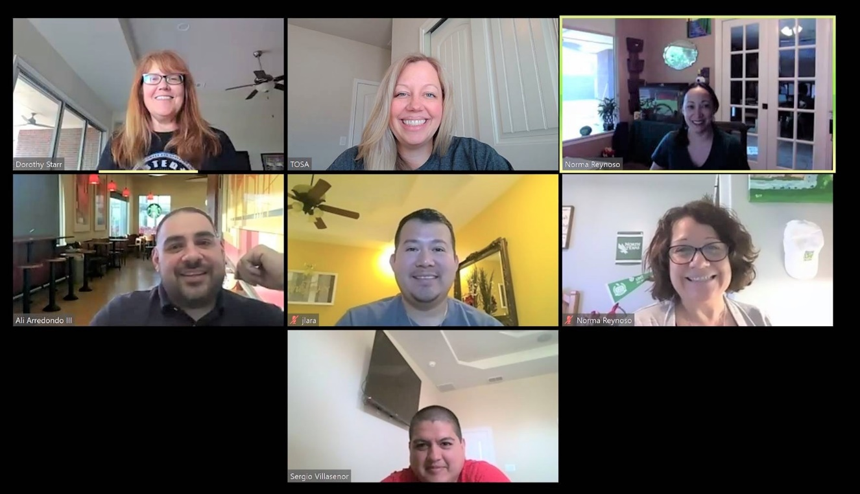
Keeping in touch
Phone & Email rounds
Zoom
Internal
Hospital Meetings
Safe physical distancing

Slide 2
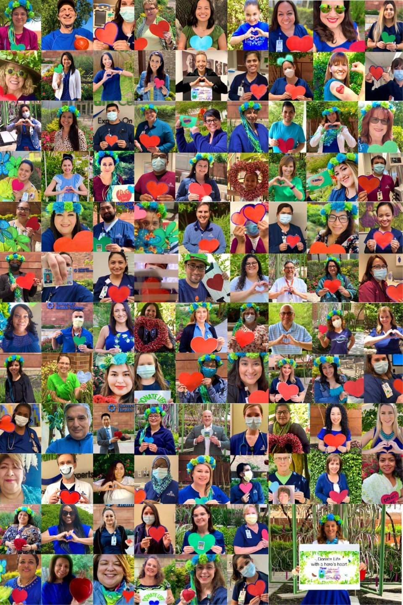
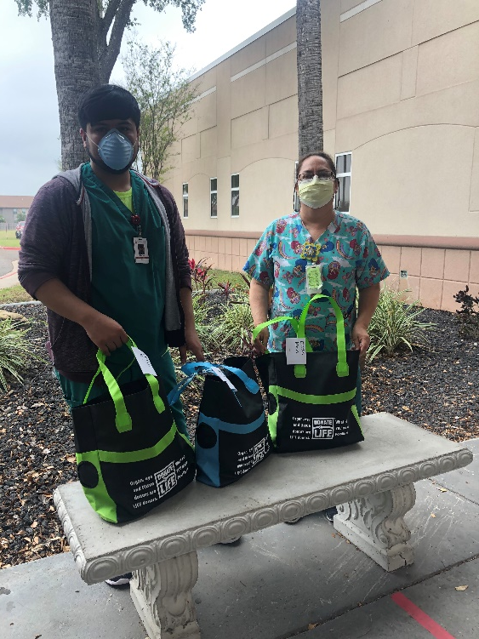
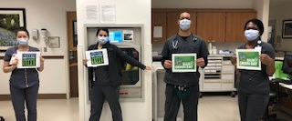
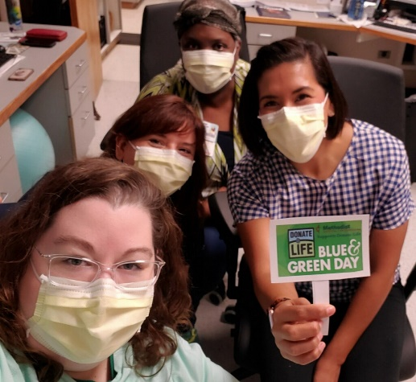
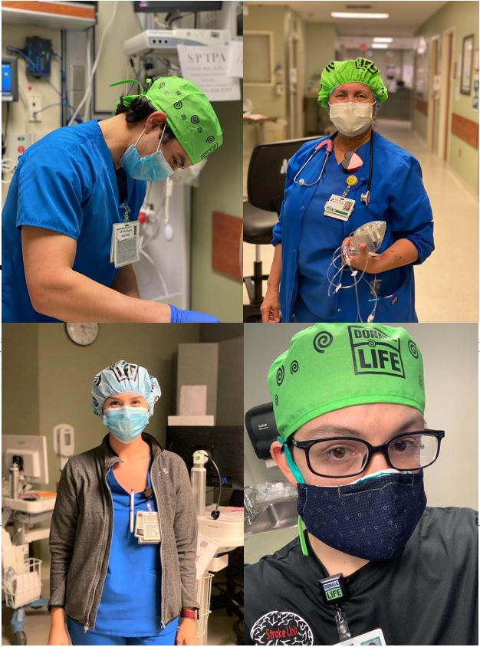
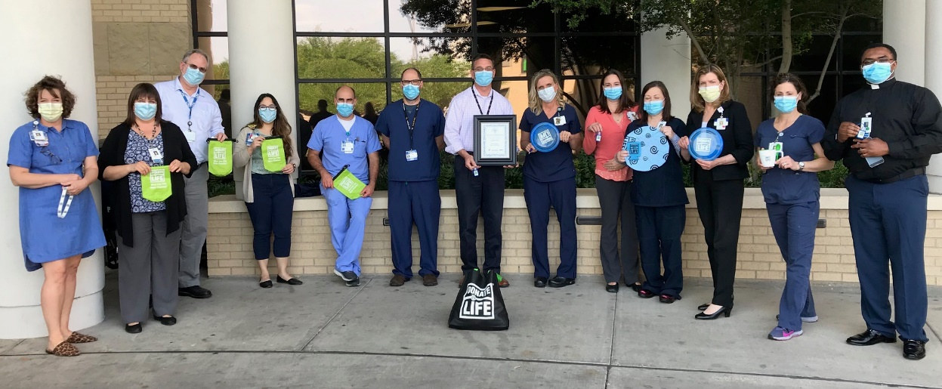
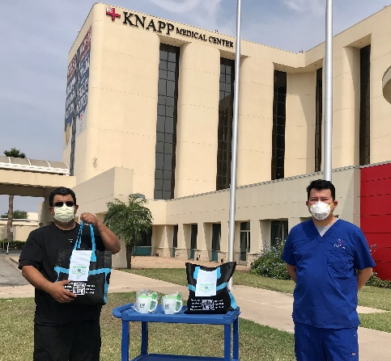
Donate Life Month
Notes:
Although formal, in-person group observances of Donate Life Month were cancelled due to COVID-19, Hospital Services partnered with our hospitals to celebrate the gift of life through physically distant swag drop-offs and presentation of Workplace Partnership for Life awards; Donate Life flag raisings; social media posts; and Blue & Green Day photo contests. Hospitals from each region collaborated with us to keep this annual tradition alive ☺
The Hospital Services team also participated in a department-wide Donate Life Month Marathon Relay, in honor of our hospital donation champions’ continued commitment to saving lives through the power of organ donation. To date (4/21), the team has surpassed our 26.2mile collaborative goal and are only a few miles from completing our 2nd marathon relay!

