Slide 1
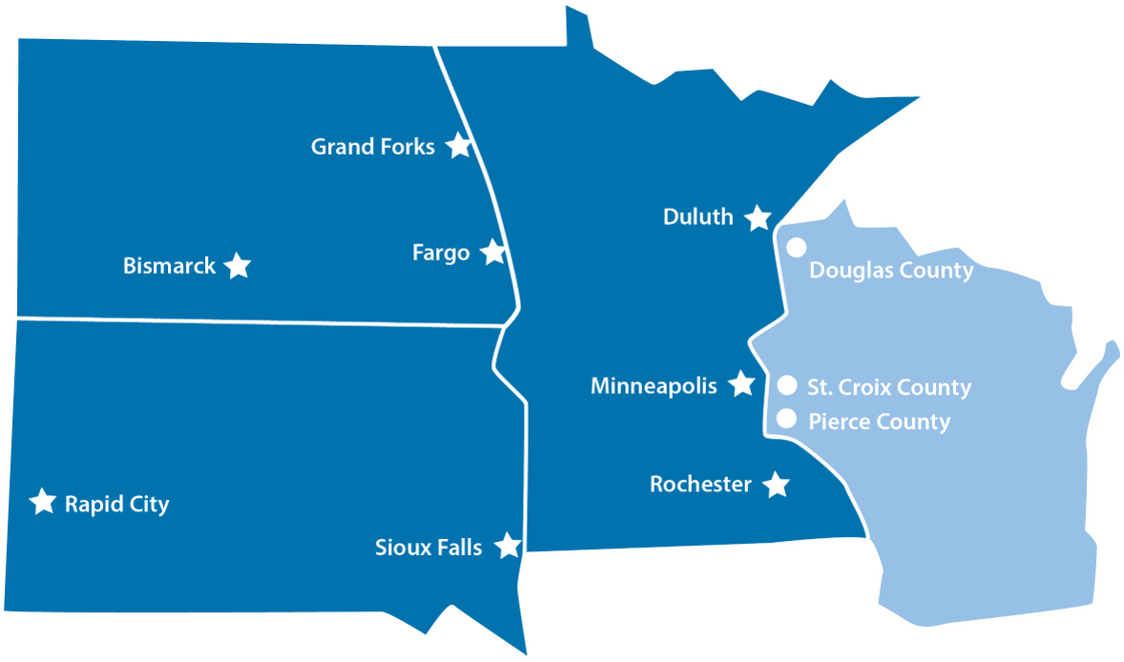
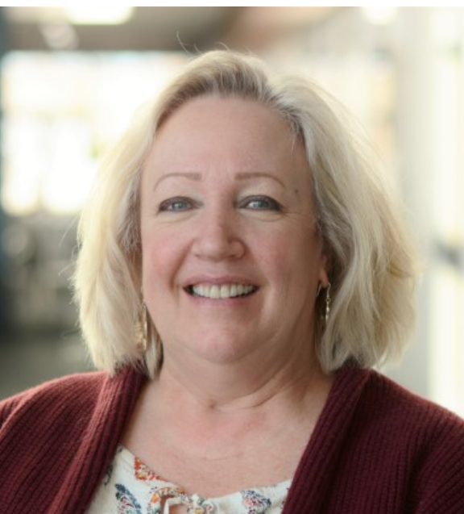
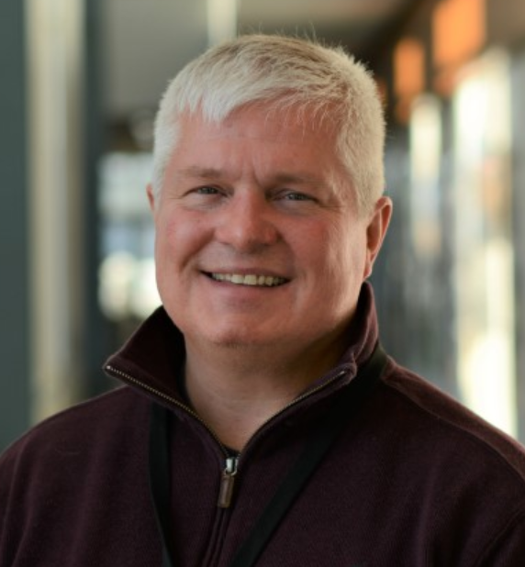
THE NUMBERS
>7.0 million people
9 transplant centers
279+ hospitals
13 hospital liaisons
LifeSource saves lives and offers hope and healing through excellence in organ, eye and tissue donation.

Slide 2
COVIDjustments March-June 2020
March
Established daily task force
Modified onsite response criteria
Initiated remote work, family support & donor mgmt.
Implemented donor testing, updated DRAI
Utilized virtual hospital rounding to track visitor policies, testing, PPE, relevant info; reflected in resource guides COVID section
Created PPE kits for OR
Partner communications: essential personnel
Regular all-team communications, including town halls
Centralized sick-call management and team member support
Modified office functions, cleaning, transport to align w CDC guidelines
Focused on supply chain for mission-critical functions
Drafted Conventional * Contingency * Crisis plan
June
LifeSource leadership team thank you video for all team members
Continued project work for longterm efficiencies:
Requests for remote EMR access
EMR documentation standards
May
Enhanced process guidance in light of hospital furloughs and rotations
Partner thank you video and communication from CEO & hospital liaisons
Launched internal video challenge to share innovations
Continued referral management refinement
April
Virtual Donate Life Month
Donor Family thank you video
N95 Fit-Testing, PPE processes
Prepared surge algorithms
Initiated ICU census tracking

Slide 3
COVIDjustments March-June 2020
March
Established daily task force
Modified onsite response criteria
Initiated remote work, family support & donor mgmt.
Implemented donor testing, updated DRAI
Utilized virtual hospital rounding to track visitor policies, testing, PPE, relevant info; reflected in resource guides COVID section
Created PPE kits for OR
Partner communications: essential personnel
Regular all-team communications, including town halls
Centralized sick-call management and team member support
Modified office functions, cleaning, transport to align w CDC guidelines
Focused on supply chain for mission-critical functions
Drafted Conventional * Contingency * Crisis plan
June
LifeSource leadership team thank you video for all team members
Continued project work for longterm efficiencies:
Requests for remote EMR access
EMR documentation standards
May
Enhanced process guidance in light of hospital furloughs and rotations
Partner thank you video and communication from CEO & hospital liaisons
Launched internal video challenge to share innovations
Continued referral management refinement
April
Virtual Donate Life Month
Donor Family thank you video
N95 Fit-Testing, PPE processes
Prepared surge algorithms
Initiated ICU census tracking

Slide 4
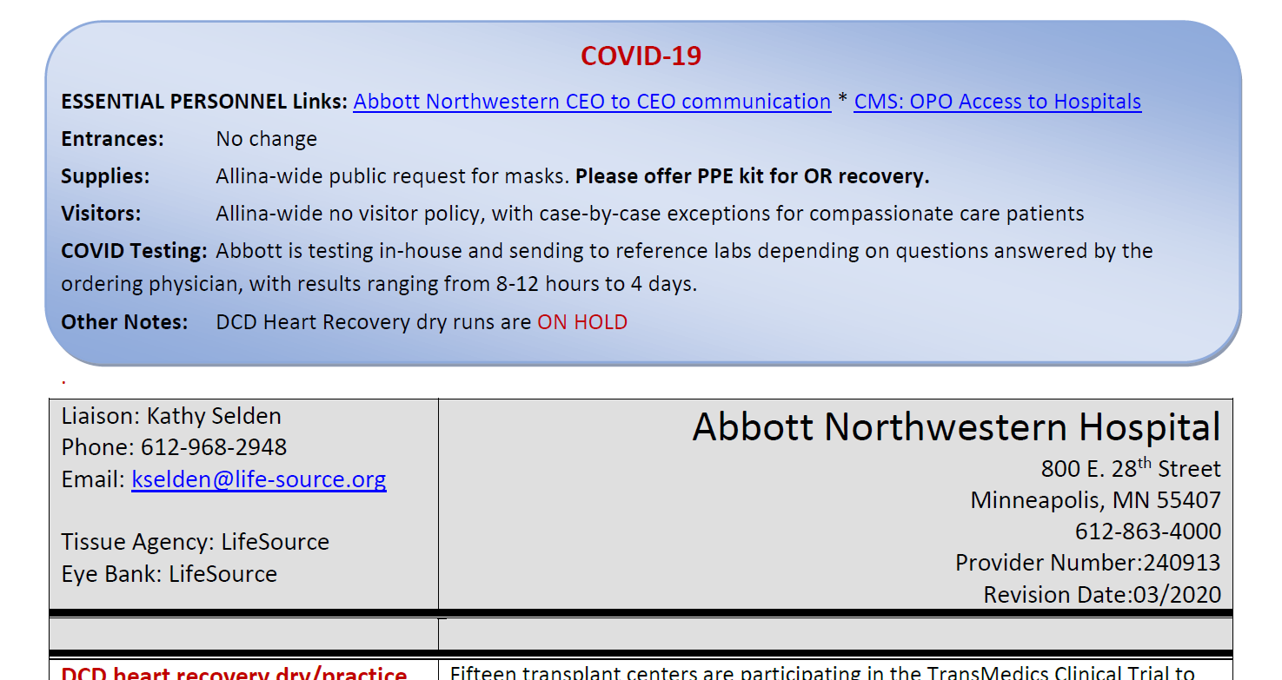
sample

Slide 5
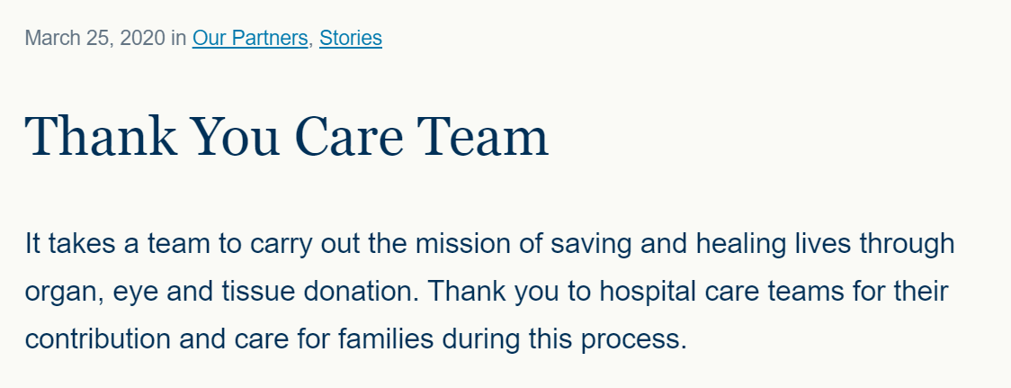

Slide 6
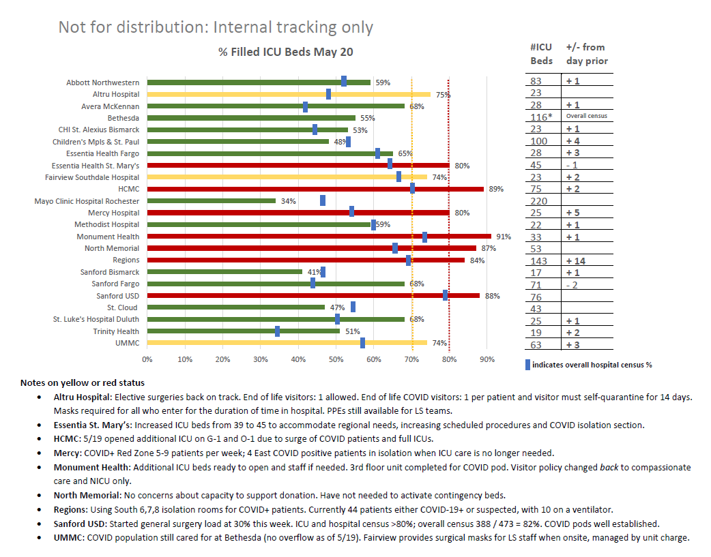
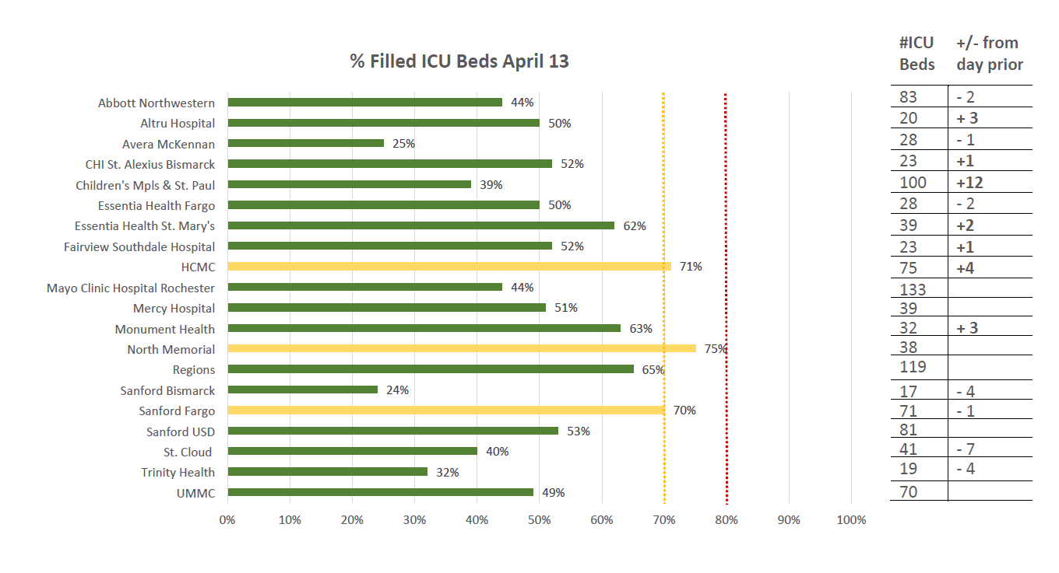

Slide 7
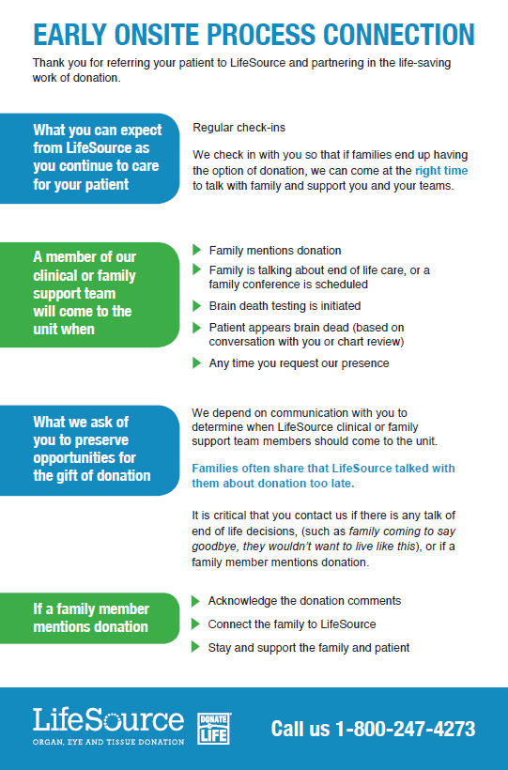
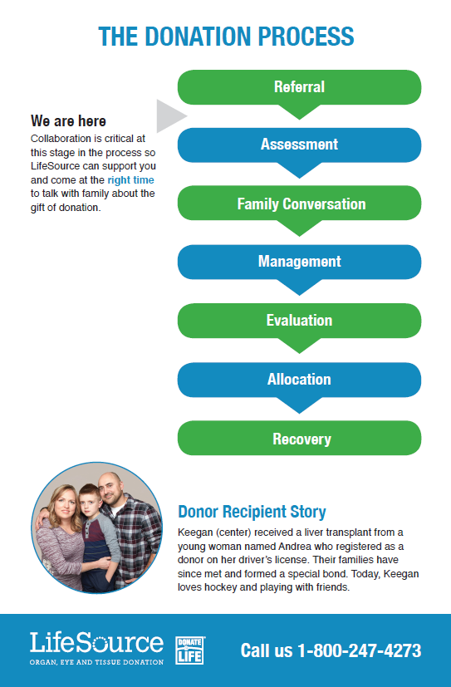

Slide 8
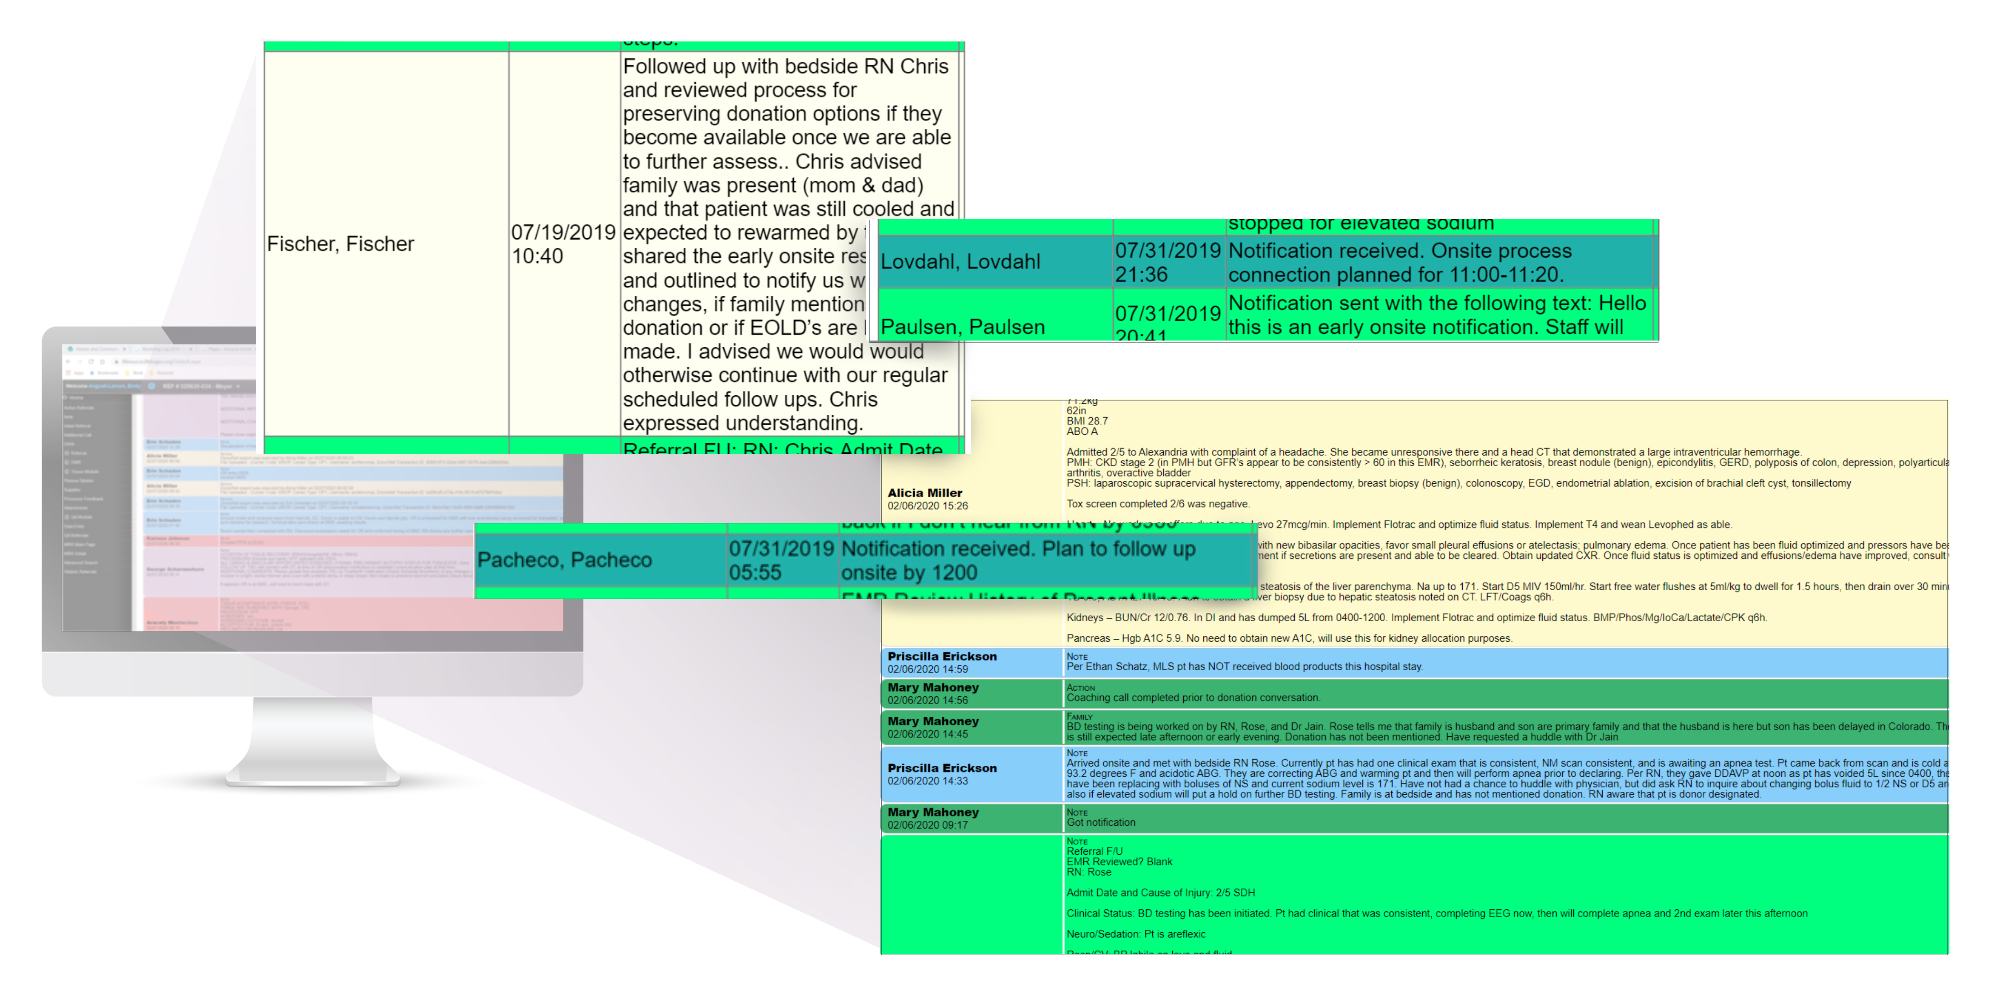

Slide 9
Hospital Development Team
Katie McKee
kmckee@life-source.org
763-516-0519

