Slide 1
Legacy of HOPe COVID Response
March
Pulled staff out of hospitals except for case evaluations for authorization and management
Started sending Memo’s to hospitals
Good response from hospitals
Established practices for COVID testing on donors
Administrative engagement to move cases forward
Telephonic rounding by Partner Services implemented
Twice daily follow ups by FSC’s on open referrals
Transfer to DRC limited to post COVID-19 testing
Only local recovery surgeons for donors

Slide 2
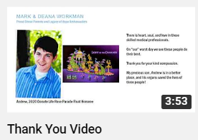
Using social media
Education
Thank you video release 04/15/2020
https://youtu.be/ptX4Le1ggxk
Partnering with Advancing Sight Network to release a short commercial to announce virtual education opportunities
Began virtual Zoom education sessions, as requested
Implementing monthly CE education sessions via Zoom
Each Partner Services Team Members building topics specific presenation
Planning “Donation in the Face of COVID-19” town hall

Slide 3
Partner Services Looking forward
Virtual donation committee meetings to resume before end of June
“Building Hope, A Partner Hospital Newsletter”
Using this as an opportunity to engage hospitals regarding:
Remote EMR access
Automated Referrals
Establish hospital specific project teams

