Slide 1
Donor Family Services & Aftercare Best Practices Summit Maximo Calderon, Supervisor Family Services Cynthia Williams, Family Services Coordinator June 18, 2020

Slide 2
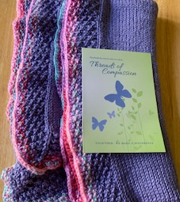
In remembrance of …
Comfort Shawls - Handmade by volunteers who care and weave these from “Threads of Compassion”.

Slide 3
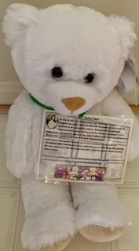
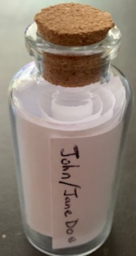
In remembrance of …
Teddy Bear which contains the “donor’s heart beat”. For more information email HollysHeartFoundation@gmail.com or visit Facebook @ Holly’s Heart Foundation
EKG script which contains the donor’s heartbeat.

Slide 4
Challenges…
Solutions…
Since COVID-19 there has been a reduction in referrals during March-April ‘20
Due to hospitals’ visitation restrictions, we have initiated more phone approaches
Overall decrease in Authorizations - families seemed to be frustrated with not being able to visit their loved one. Express they do not want any further delays, which result in “a hard no” - Minimal pro-donation from minority communities
Continue to practice safety precautions (social distancing, washing hands, etc.)
During phone approaches, extend more empathy, and offer donation within first 60 seconds of conversation
Dual Approaches – better connection w/family, support cross cultural, race, and gender, etc.
Meet families at their home or other public settings
Work with Community Affairs to identify demographic areas where authorizations are low; conduct more outreach gatherings and education.

Slide 5
QUESTIONS & COMMENTS

